Slide 1
Path Sampling methods for rare event problems
Anil, Shiladitya
JNCASR, Bangalore

Slide 2
Outline of the talk
Introduction to the rare events
Introduction to Nucleation process
Methods for simulating rare events
Aim of the our project
Simulation details
Results
Conclusion
Future plans

Slide 3
Rare Event Problems ???
When two stable states of a system are separated by a energy barrier, transition from one state to other state is very infrequent but if happens due to fluctuation in the system, it is very fast.
Nucleation process
Chemical reactions
Protein aggregation process

Slide 4





Problem with rare events simulation :: nucleation process
Experimental nucleation rates:
Simulation:
Volume is much smaller (e.g. for one million particles ) :
V =
Nucleation rate
One event per
One event per MD times steps
Brute force simulations won’t work…..
Solution : Umbrella sampling, TPS, and other methods which we will discuss……

Slide 5
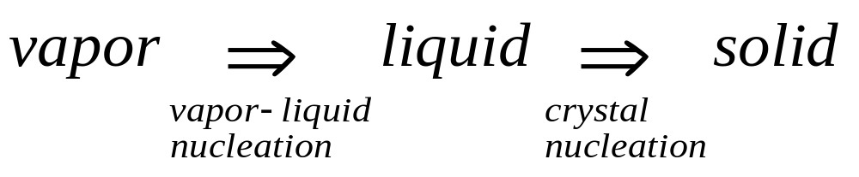
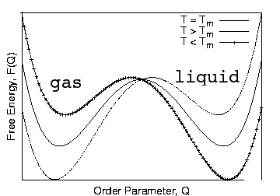
Phase transition

Slide 6
Introduction to Nucleation Process
When we cool the gas(liquid) below the boiling(melting) temperature, spontaneously it does not form liquid(crystal) although liquid(crystal) is stable state below the boiling(melting) temperature, Why??
Formation of the liquid(crystal) from the vapor(liquid), in metastable state, requires the formation of a critical nuclei of liquid(crystal). Until this critical nuclei does not form, vapor(liquid) does not form liquid(crystal).
The process of the formation of critical nuclei is called nucleation process.
Why does it require critical nuclei ??

Slide 7
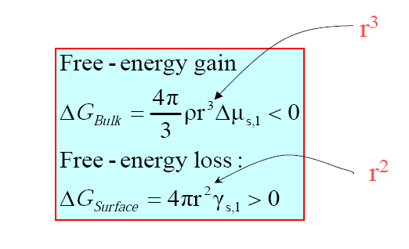
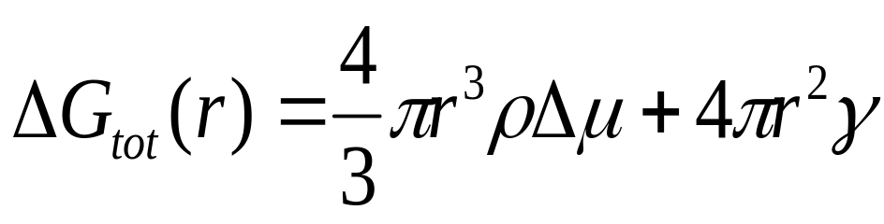
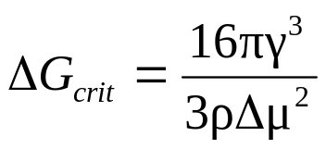
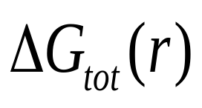
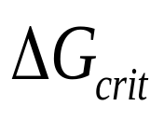
Nucleation process: CNT
~ r²
~ -r³
0
r_{c}
r

Slide 8
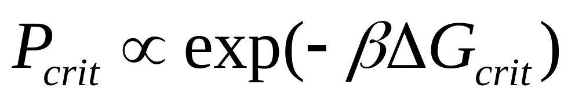
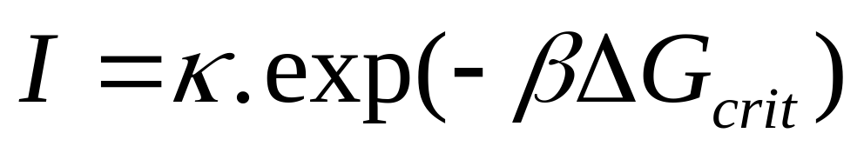
Bennett -Chandler Approach
First define a reaction coordinate
Locate the transition state
Calculate the kinetic prefactor.
Calculate the rate constant

Slide 9
Difficulties with Bennett Chandler Approach
For Complex system the transition from one state to other state depends on many reaction coordinates.
Hence, for complex system it is very difficult to define transition state accurately.

Slide 10
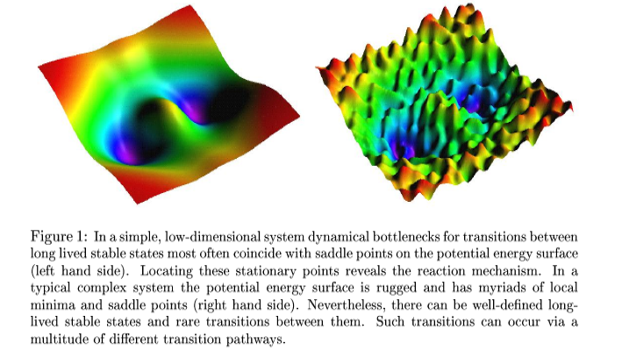
Transition Path Sampling

Slide 11
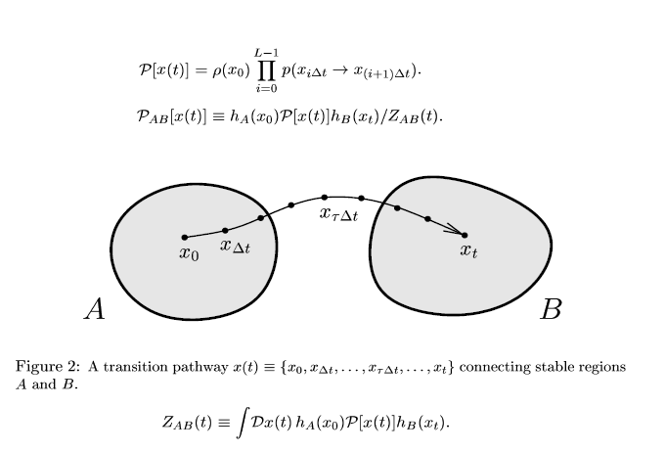
How to define transition path??

Slide 12
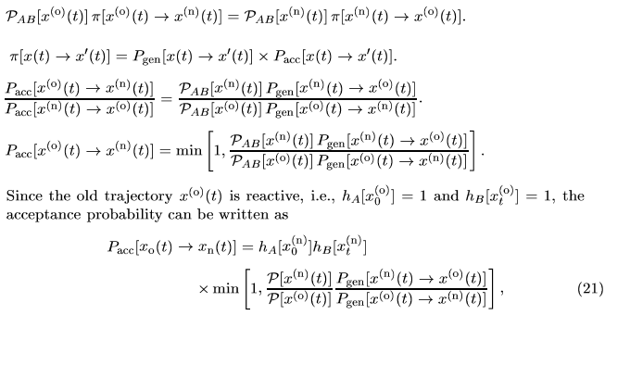
Sampling the TPS

Slide 13
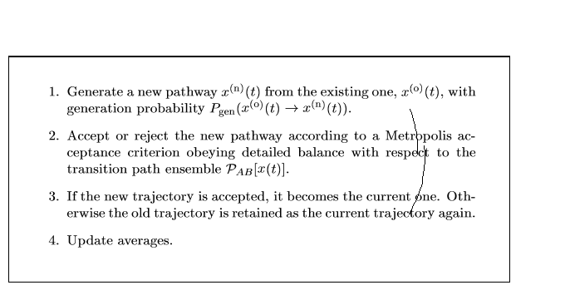
Algorithm for TPS

Slide 14
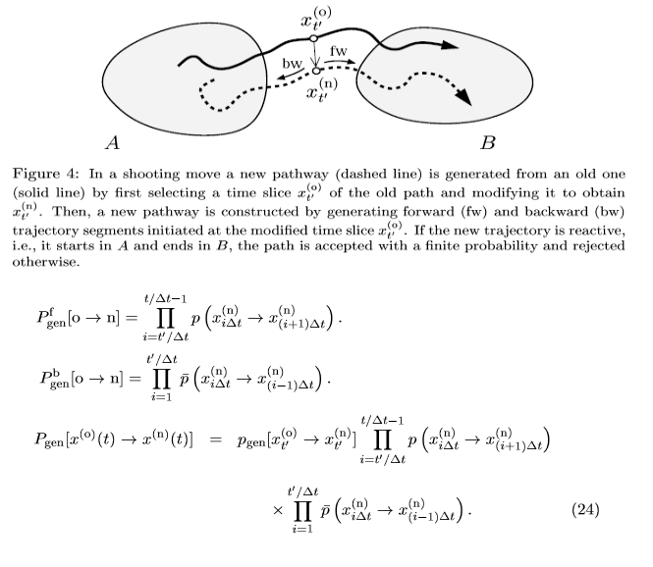
Generation of new transition path:: Shooting move

Slide 15
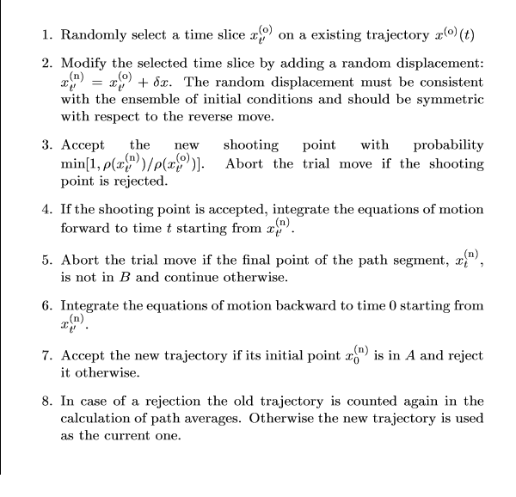
Algorithm for shooting method

Slide 16
Difficulties with Transition path sampling
Advantage of TPS over Bennett-Chandler method is that it do not require the knowledge of the transition state but can be use to calculate activation energy barrier and rate constant.
Transition path sampling method requires the knowledge of the initial transition path connecting two stable states. For complex system it is very difficult to find optimum initial path connecting two states. One can find this pathway using brute force simulation ( for very high degree of super cooling in case of nucleation) but it will take very long time to converge to stable trajectory in the TPE at desired degree of the super cooling.
. Recently, Frankel Showed that one can generate true TPE trajectory without knowledge of the initial pathway connecting the two states.

Slide 17
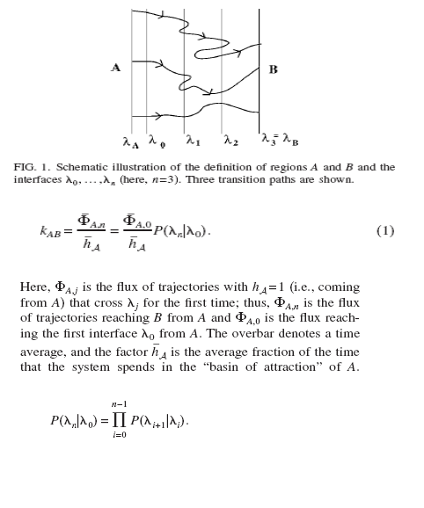

Frankel Approach

Slide 18
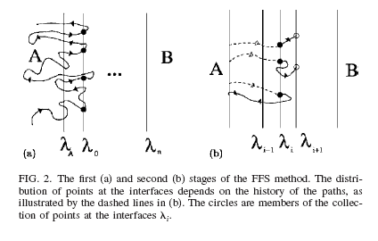
Forward Flux Sampling (FFS) Method

Slide 19
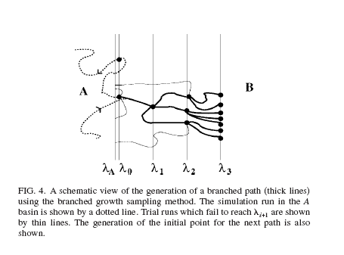
Branched Growth (BG) Method

Slide 20
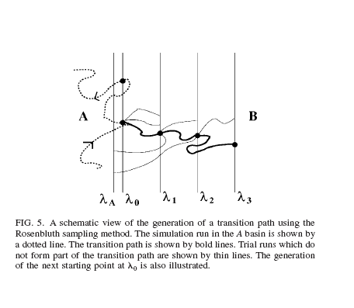
Rosenbluth Sampling

Slide 21
Conclusions from literature survey
Bennett –Chandler approach can be used to study rare event problem if we can locate the transition state as function of the reaction coordinates.
Transition path sampling can be used without the knowledge of the transition state and but we for this method we need to know one initial transition path connecting the two stable states.
FFS , BG and RB method do not require knowledge of the initial trajectory connecting the two states but generate correct TPS ensemble.
All methods can calculate the activation energy barrier and rate constant.
Hence, FFS, BG and RB are the robust methods
for simulating rare event problems.

Slide 22
Aim of our project
We want to develop/implement efficient and robust technique to simulate rare event problems.
To check the techniques, we have selected
the problem of calculating the free energy barrier and rate constant for vapor-liquid transition. This problem has already been done by the Wolde et. al. using the Umbrella sampling. So we are doing this FFS method.

Slide 23
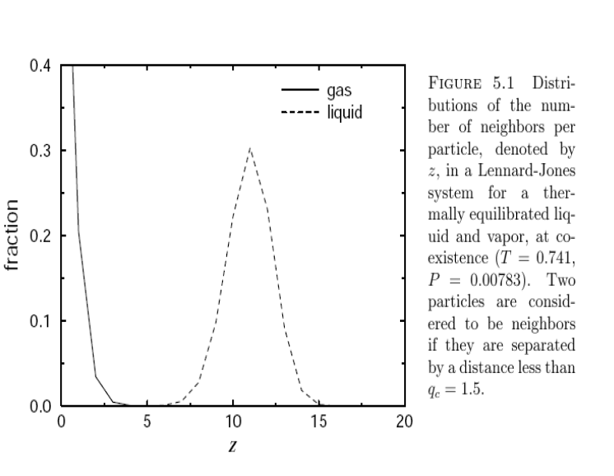
Reaction coordinate for Liquid vapor transition

Slide 24
Simulation details
We are doing NPT MC simulation with N= 108,…
( T* = 0.74,, P* = 0.014 ) particles interacting with Lennard-Jones potential in a periodic cubic simulation box.
We are using spherical cut off 2.5 for interaction.
The reaction coordinate for the FFS method is largest size liquid cluster present in the system.
The reaction coordinates slice is 5 for the FFS.
Bond length for liquid like particle is 1.5, which is first minimum of the radial distribution function for Lennard-Jones liquid.

Slide 25
Challenges in rare events
Free energy barrier may be high.
There can be more than one characteristic time scale with order of magnitude difference.
Reaction coordinate transition mechanism
may be ill defined.

Slide 26
What is path sampling
Directly samples of a collection of paths connecting reactant and product states.
Advantage:
No prior knowledge of reaction coordinates or reaction mechanism is required.

Slide 27
Pioneering method: Transition Path Sampling (TPS) Dellago et. al. October 1997
Our focus :
Transition Interface Sampling (TIS): van Erp et. Al. May 2003
Forward Flux Sampling (FFS) : Allen et. Al.
January 2006

Slide 28
Rate constant by Transition Interface Sampling
Division of phase space by non intersecting interfaces
Effective positive flux through λ₁
Probability of going from λ₁ to λ_{n}.

Slide 29
First step of TIS:
The phase space is divided by ‘n’ no. of nonintersecting hyper surfaces
λ_{i} = constant
Choose an order parameter λ which may be any simple or complicated function of
phase space coordinates.
Only requirement :
λ should unambiguously define the state A and B and the intermediate regions i.e. the starting, finishing and the intermediate condition of the simulation.

Slide 30
P_{A}(λ_{ι+1}| λi) = probability of going from interface i to i+1
Ιn TIS it is measured in the following way:
Let us take ‘N’ independent trajectories that start at A.
Let ‘m’ of them cross interface ‘ i ‘ and also reach interface ‘i + 1’ without recrossing ‘i’ and then return to A.
The rest of ‘N-m’ trajectories crosses ‘i’ and then return to A.
P_{A}(λ_{ι+1}| λi) = m/N
Repeat iteratively for all i and multiply.

Slide 31
Finally..
Probability of going from interface ‘i’ to interface ‘i +1’ is
= No. of paths connecting A to ‘i+1’/Total no. of paths for the interface ‘i’

Slide 32
Pros and cons of TIS
Conceptually simple.
Paths eventually unsuccessful to reach B
also contribute to rate constants . So
statistical accuracy improved.
No restriction on choice of order parameter.

Slide 33
Simulation runs from one interface to next interface only . Hence requires less time.
However ..
the backward move from the interfaces far away from A should take longer time/lesser probability.

Slide 34
Rate Constant by Forward Flux Sampling
By avoiding the backward shooting move , the algorithm is further simplified.
Same expression for rate constants
K = rate of flux through interface 1 * probability of going from 1 to B

Slide 35
To compute the probability
  generate many trajectories from A
  store N₀ first crossings at interface ‘1’
  Generate ‘m’ trial runs by selecting any one of them randomly.
fraction that reaches interface ‘2’ is the estimate of probability of reaching ‘2’ from ‘1’.
Repeat this for all subsequent interfaces.

Slide 36
Pros and cons of FFS
Applicable to non equilibrium system.
But, limited to stochastic systems only..

Slide 37
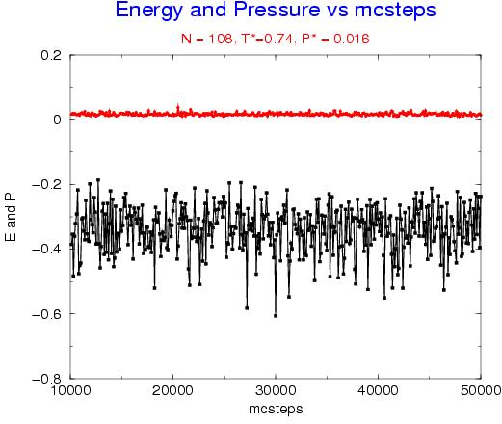
Results:

Slide 38
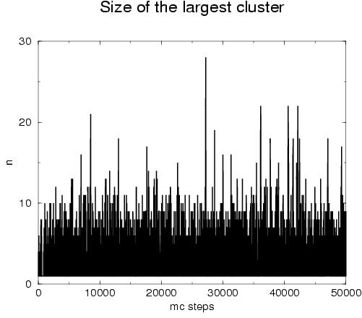
Results:

Slide 39
Future plans
Calculate the rate constant for gas liquid transition using the FFS method and apply
this method to study the rate constant for
crystallization process.
. To implement other methods i.e. BG and RB for calculating the rate constants for the rare events.

